Slide 1
Class Assessment
Maiza Zanib
Lecturer Physics

Slide 2
Electricity
Electricity is the flow of electrical power or charge. It is a secondary energy source which means that we get it from the conversion of other sources of energy, like coal, natural gas,oil, nuclear power and other natural sources, which are called primary sources. The energy sources we use to make electricity can be renewable or non-renewable, but electricity itself is neither renewable or non-renewable.
Electricity is measured in units of power called watts.

Slide 3
Types
Current
Current is a flow of electrical charge carriers, usually electrons or electron- deficient atoms.
Electrostatic
Electrostatics involves the buildup of charge on the surface of objects due to contact with other surfaces.

Slide 4
Electric Force and Charges CHECK YOUR NEIGHBOR
When you brush your hair and scrape electrons from your hair, the charge of your hair is
positive.
negative.
Both A and B.
Neither A nor B.

Slide 5
Electric Force and Charges CHECK YOUR ANSWER
When you brush your hair and scrape electrons from your hair, the charge of your hair is
positive.
negative.
Both A and B.
Neither A nor B.
Comment:
And if electrons were scraped off the brush onto your hair, your hair would have a negative charge.

Slide 6

Conservation of Charge
Conservation of charge
– In any charging process, no electrons are created or destroyed. Electrons are simply transferred from one material to another.

Slide 7
Coulomb's Law
CHECK YOUR NEIGHBOR
According to Coulomb's law, a pair of particles that are placed twice as far apart will experience forces that are
half as strong.
one-quarter as strong.
twice as strong.
4 times as strong.

Slide 8
Coulomb's Law
CHECK YOUR ANSWER
According to Coulomb's law, a pair of particles that are placed twice as far apart will experience forces that are
half as strong.
one-quarter as strong.
twice as strong.
4 times as strong.

Slide 9
Conductors and Insulators CHECK YOUR NEIGHBOR
When you buy a water pipe in a hardware store, the water isn't included. When you buy copper wire, electrons
must be supplied by you, just as water must be supplied for a water pipe.
are already in the wire.
may fall out, which is why wires are insulated.
None of the above.

Slide 10
Conductors and Insulators CHECK YOUR ANSWER
When you buy a water pipe in a hardware store, the water isn't included. When you buy copper wire, electrons
must be supplied by you, just as water must be supplied for a water pipe.
are already in the wire.
may fall out, which is why wires are insulated.
None of the above.

Slide 11
Superconductors
Superconductors: Materials acquire zero resistance (infinite conductivity) to the flow of charge.
Once electric current is established in a superconductor, the electrons flow indefinitely.
With no electrical resistance, current passes through a superconductor without losing energy.
No heat loss occurs when charges flow.

Slide 12
Examples
niobium, magnesium diboride, cuprates such as yttrium barium copper oxide.

Slide 13
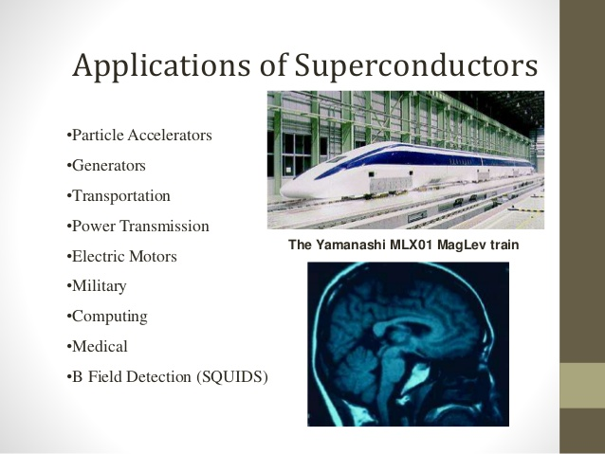

Slide 14
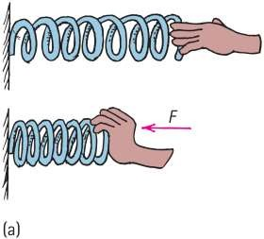
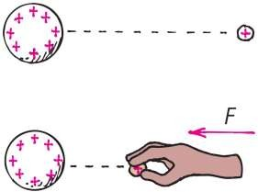
Electric Potential
(a) The spring has more mechanical PE when compressed. (b) The charged particle similarly has more electric PE when pushed closer to the charged sphere. In both cases, the increased PE is the result of work input.

Slide 15
Electric Potential
Electric potential (voltage)
the amount of work energy needed to move a unit of electric charge from a reference point to the specific point in an electric field.
Energy per charge possessed by a charged particle due to its location
May be called voltage — potential energy per charge
In equation form:
electric potential energy
Electric potential =
amount of charge

Slide 16
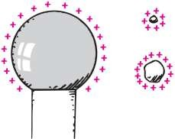
Electric Potential
Electric potential (voltage) (continued)
1 joule
– Unit of measurement: volt, 1 volt = _{1 coulomb}
Example:
Twice the charge in same location has twice the electric potential energy but the same electric potential.

Slide 17
Electric Potential
CHECK YOUR NEIGHBOR
Electric potential energy is measured in joules. Electric potential, on the other hand (electric potential energy per charge), is measured
in volts.
in watts.
in amperes.
also in joules.

Slide 18
Electric Potential CHECK YOUR ANSWER
Electric potential energy is measured in joules. Electric potential, on the other hand (electric potential energy per charge), is measured
in volts.
in watts.
in amperes.
also in joules.

Slide 19


